Slide 1

Object Detection
Anchor boxes
deeplearning.ai

Slide 2
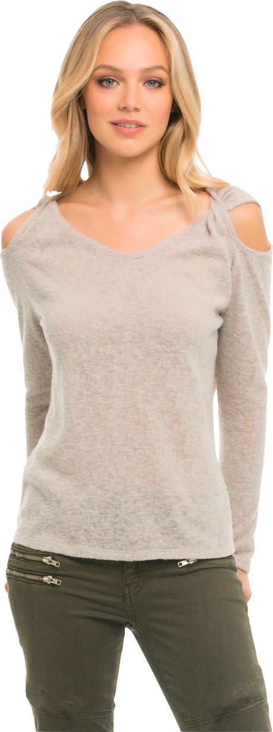
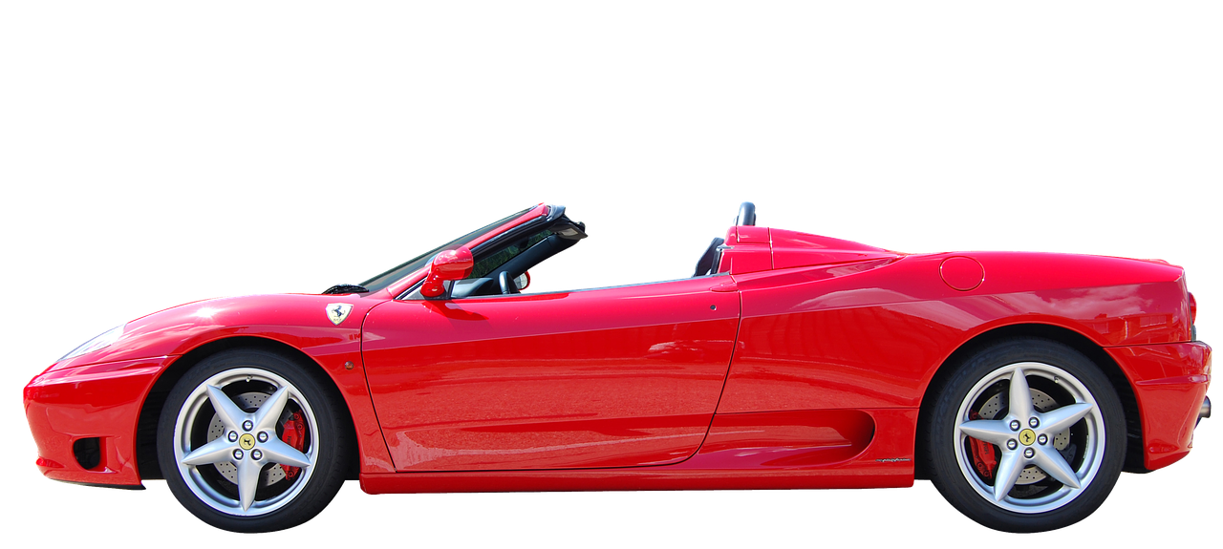
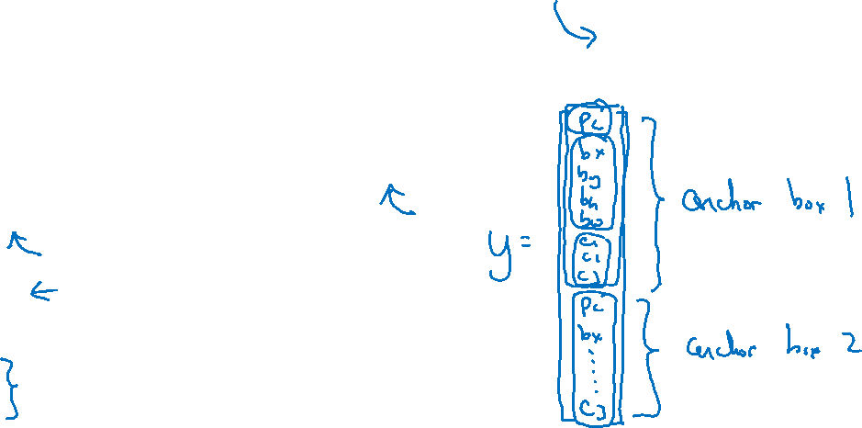

Overlapping objects:
Anchor box 1:
Anchor box 2:
$$\left[\begin{aligned}p_{c} \\ b_{x} \\ b_{y} \\ b_{h} \\ b_{w} \\ c_{1} \\ c_{2} \\ c_{3}\end{aligned}\right]$$
y =
[Redmon et al., 2015, You Only Look Once: Unified real-time object detection]

Slide 3
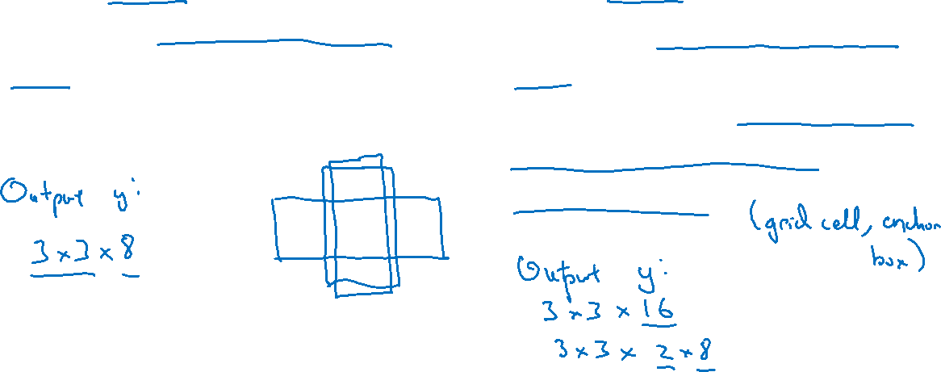
Anchor box algorithm
Previously:
With two anchor boxes:
Each object in training image is assigned to grid cell that contains that object’s midpoint.
Each object in training image is assigned to grid cell that contains object’s midpoint and anchor box for the grid cell with highest IoU.

Slide 4
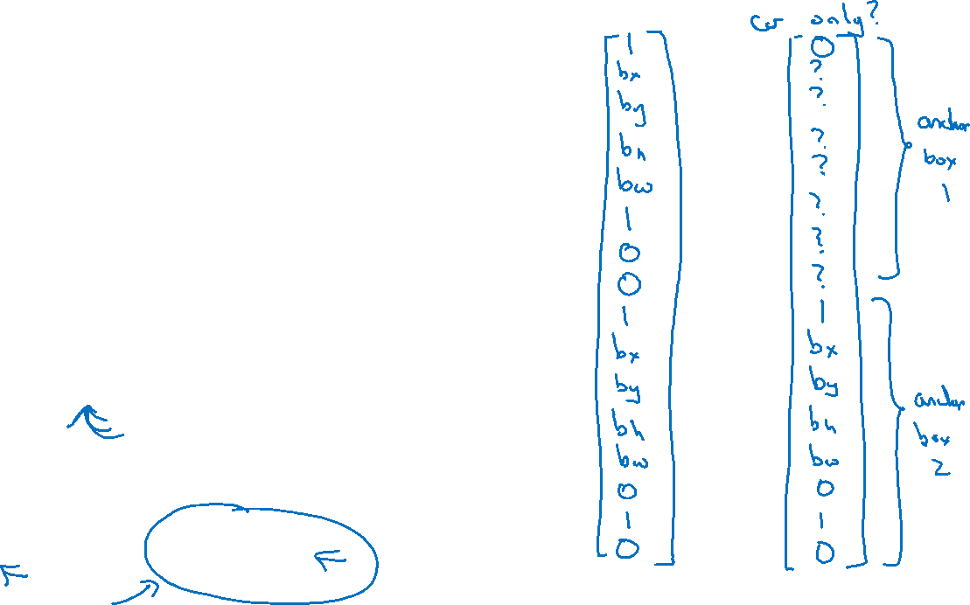
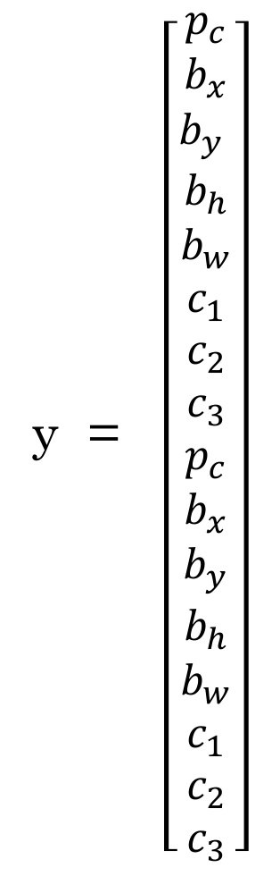
Anchor box example
y = $\left[\begin{aligned}p_{c} \\ b_{x} \\ b_{y} \\ b_{h} \\ b_{w} \\ c_{1} \\ c_{2} \\ c_{3} \\ p_{c} \\ b_{x} \\ b_{y} \\ b_{h} \\ b_{w} \\ c_{1} \\ c_{2} \\ c_{3}\end{aligned}\right]$
Anchor box 1:
Anchor box 2:

